Slide 1
Parallel Computation On COMET using Spark
- Sravya Jarugu

Slide 2
Spark is an open source processing engine built around speed, ease of use, and analytics. If you have large amounts of data that requires low latency processing that a typical MapReduce program cannot provide, Spark is the way to go.
Spark Notebook is the open source notebook aimed at enterprise environments, providing Data Scientist and Data Engineers with an interactive web-based editor that can combine Scala code, SQL queries, Markup and JavaScript in a collaborative manner to explore, analyze and learn and parallelize massive data sets.

Slide 3
Spark is written in Scala and are executed by a Java machine (JVM) which are mostly compatible with Java. Spark also provides APIs in various languages, e.g. Python, R, Java; other languages. however, the most reliable way of programming Spark is the Scala API, since other languages’ APIs tend to lag behind implementing newer Spark functionalities. Spark has its own Resource manager to manage the machines on the cluster.
It can be run in two modes:
Batch Processing Mode
Interactive Mode

Slide 4
STEPS TO FOLLOW:
Log into the comet
Request for three to four machines on COMET using the command
salloc -A sun117 –nodes=3 –p compute –t 2:00:00
Use the head node of the cluster as the master machine and connect to the head node.
ssh comet-ab-cd
Edit the ‘slaves’ file to list the other machines
comet-ab-ef
comet-ab-gh

Slide 5
Start the master and slave machines by the following command
start-master.sh
start-slaves.sh
Tunnel the web traffic using the following command
putty -L localhost:9000:localhost:9000 you@comet-12-34.sdsc.edu
Start Your Spark Notebook then by the command
Spark-notebook

Slide 6
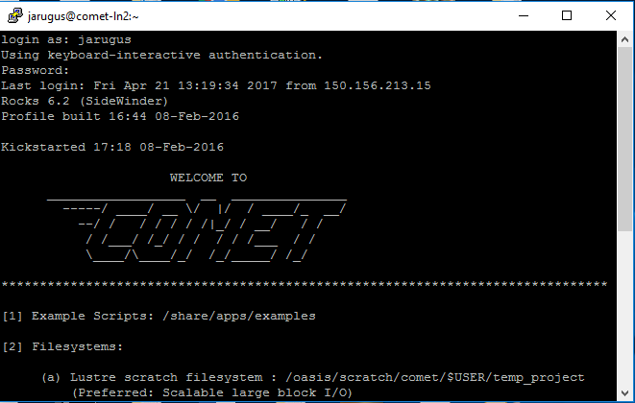

Slide 7
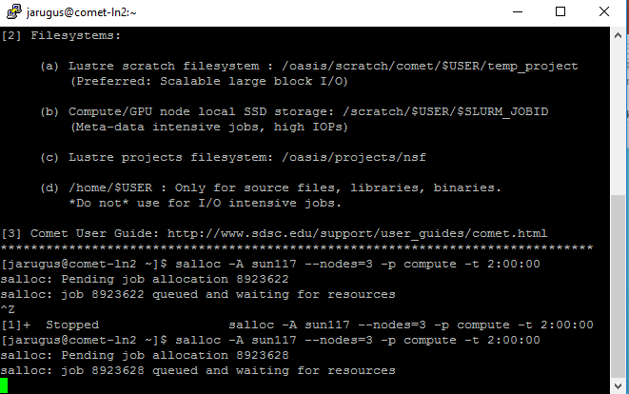

Slide 8
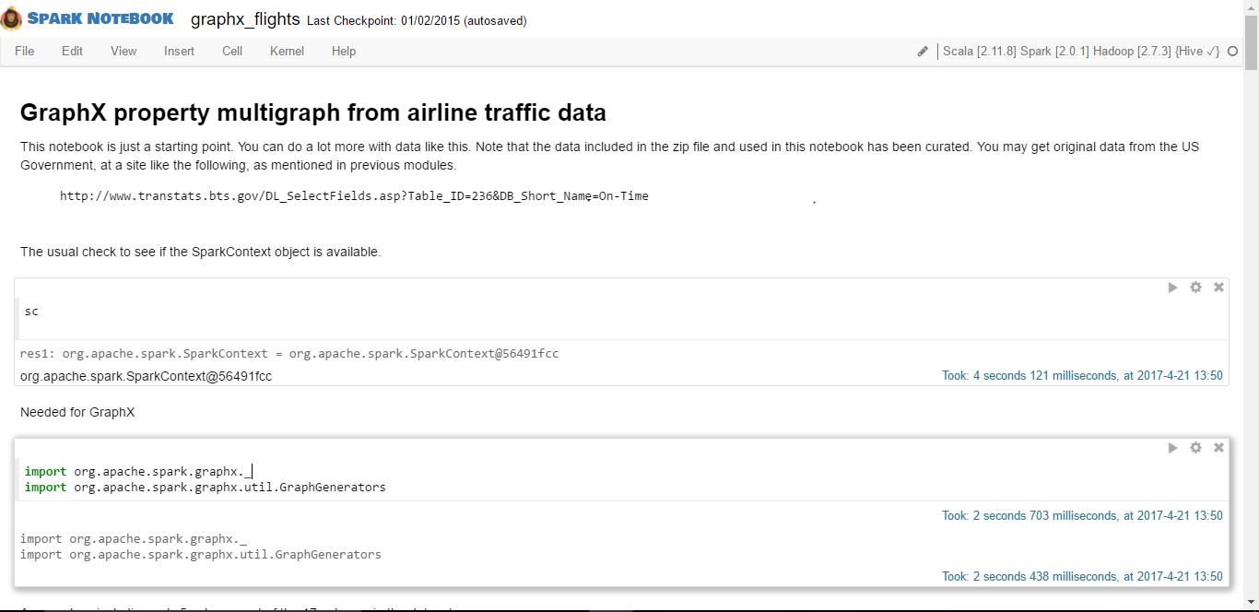
Resilient Distributed Datasets (RDD) is a fundamental data structure of Spark. It is an immutable distributed collection of objects. Each dataset in RDD is divided into logical partitions, which may be computed on different nodes of the cluster.

Slide 9
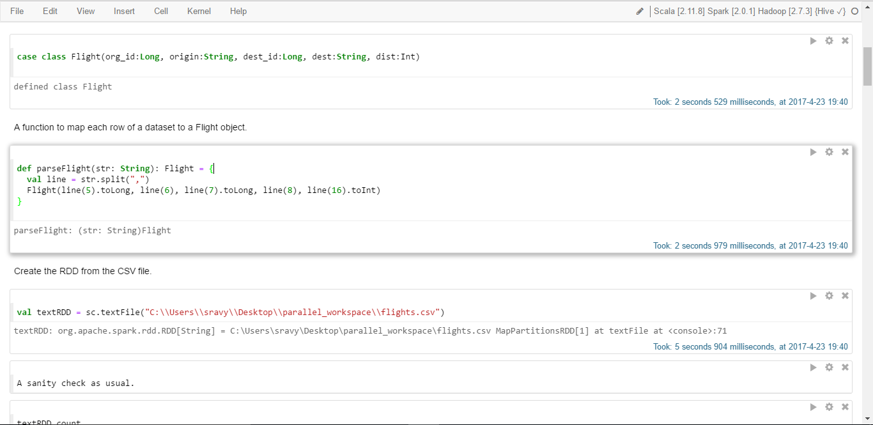

Slide 10
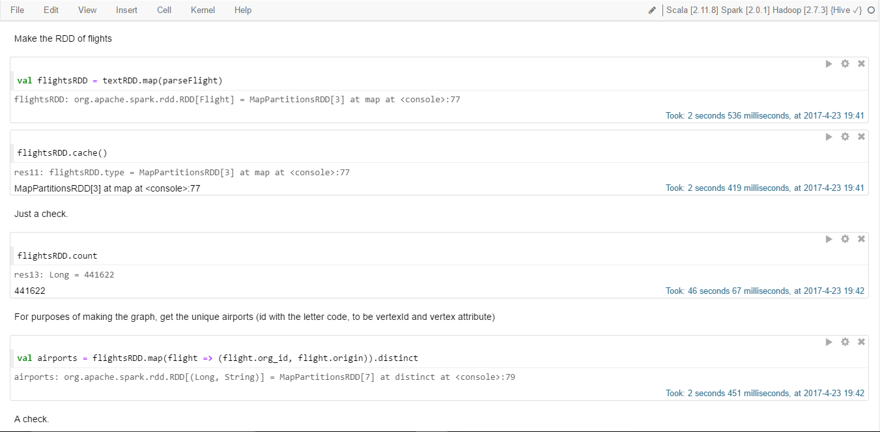

Slide 11
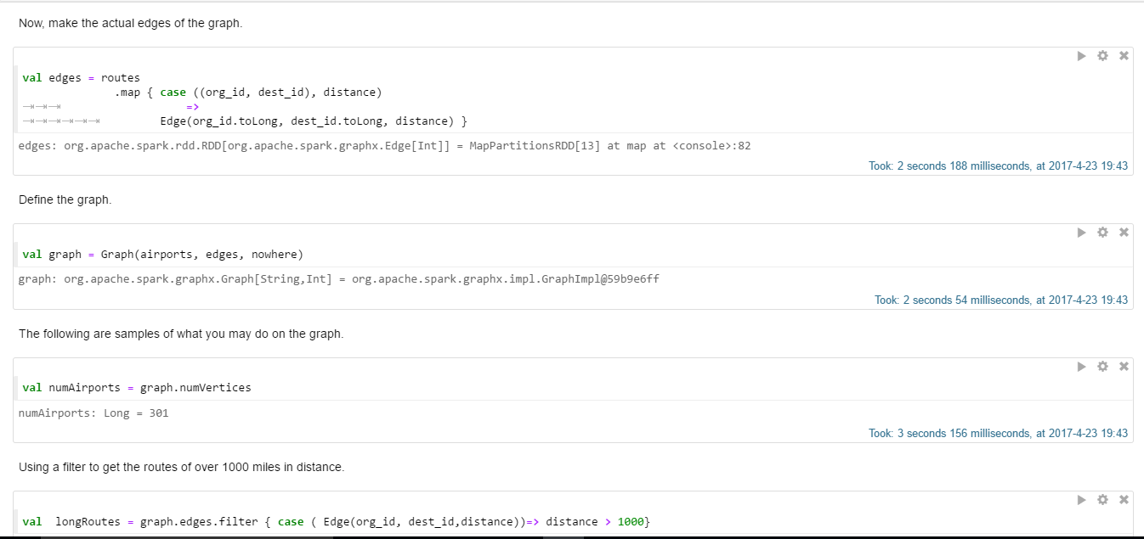

Slide 12
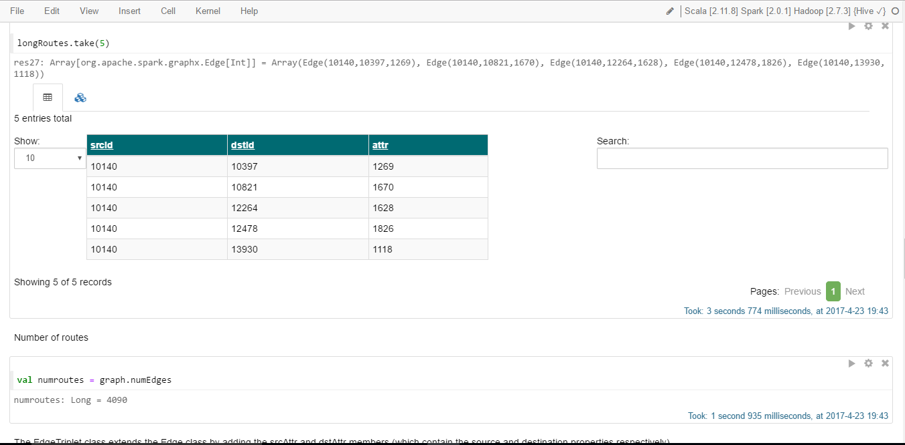

Slide 13
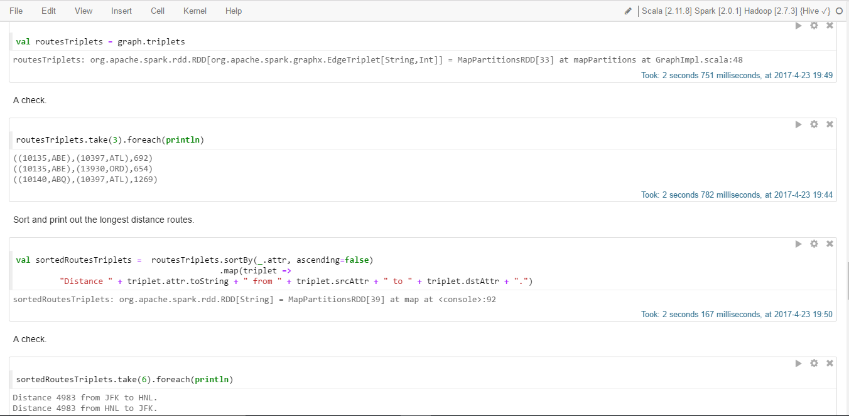

Slide 14
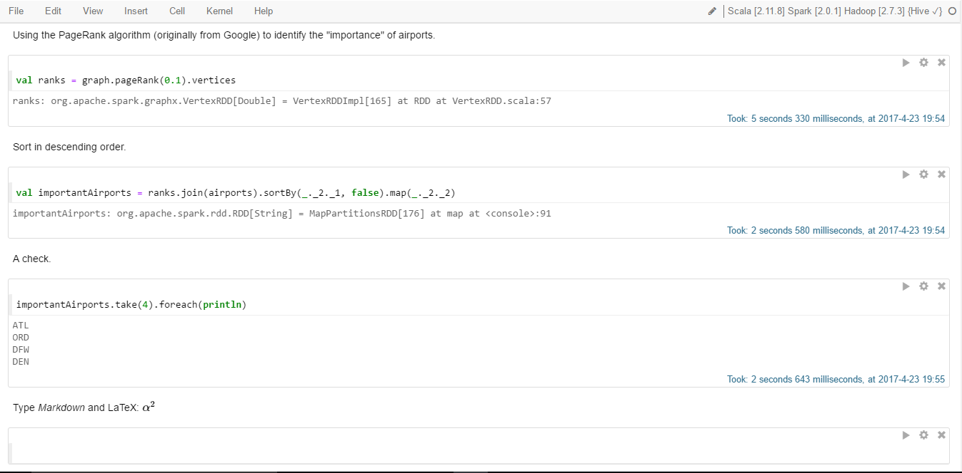

Slide 15
If you want to run MPI then do the following:
Edit your .bashrc file emacs –nw ~/.bashrc
alias hadoop02='ssh -Y yourusername@hadoop02.dyndns.org
alias hadoop03='ssh -Y yourusername@hadoop03.dyndns.org
alias hadoop04='ssh -Y yourusername@hadoop04.dyndns.org
Now you should be able to connect to the servers using their name only. For example:
hadoop2
this should connect you to hadoop02 directly.
First create a directory called mpi and then cd to this directory and create the following C program

Slide 16
emacs -nw helloWorld.c
// hello.c
// A simple hello world MPI program that can be run
// on any number of computers
#include <mpi.h>
#include <stdio.h>
int main( int argc, char *argv[] ) {
int rank, size, nameLen;
char hostName[80];
MPI_Init( &argc, &argv); /* start MPI */
MPI_Comm_rank( MPI_COMM_WORLD, &rank ); /* get current process Id */
MPI_Comm_size( MPI_COMM_WORLD, &size ); /* get # of processes */
MPI_Get_processor_name( hostName, &nameLen);
printf( "Hello from Process %d of %d on Host %s\n", rank, size, hostName );
MPI_Finalize();
return 0;
}

Slide 17
Compile and Run the program:
mpicc -o hello helloWorld.c
mpirun -np 2 ./hello
Hello from Process 1 of 2 on Host Hadoop01
Hello from Process 0 of 2 on Host Hadoop01
If you see the two lines starting with "Hello world" on your screen, MPI was successfully installed on your system!

